Slide 1
MySQL Stored Function
A stored function is a special kind stored program that returns a single value. Typically, you use stored functions to encapsulate common formulas or business rules that are reusable among SQL statements or stored programs.
Different from a stored procedure, you can use a stored function in SQL statements wherever an expression is used. This helps improve the readability and maintainability of the procedural code.
To create a stored function, you use the CREATE FUNCTION statement.

Slide 2
MySQL CREATE FUNCTION syntax
The following illustrates the basic syntax for creating a new stored function:
DELIMITER $$
CREATE FUNCTION function_name(
param1,
param2,…
)
RETURNS datatype
[NOT] DETERMINISTIC
BEGIN
-- statements
END $$
DELIMITER ;

Slide 3
In this syntax:
First, specify the name of the stored function that you want to create after CREATE FUNCTION keywords.
Second, list all parameters of the stored function inside the parentheses followed by the function name. By default, all parameters are the IN parameters. You cannot specify IN , OUT or INOUT modifiers to parameters
Third, specify the data type of the return value in the RETURNS statement, which can be any valid MySQL data types.
Fourth, specify if a function is deterministic or not using the DETERMINISTIC keyword.

Slide 4
A deterministic function always returns the same result for the same input parameters whereas a non-deterministic function returns different results for the same input parameters.
If you don’t use DETERMINISTIC or NOT DETERMINISTIC, MySQL uses the NOT DETERMINISTIC option by default.
Fifth, write the code in the body of the stored function in the BEGIN END block. Inside the body section, you need to specify at least one RETURN statement. The RETURN statement returns a value to the calling programs. Whenever the RETURN statement is reached, the execution of the stored function is terminated immediately.

Slide 5
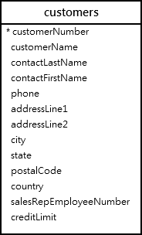
MySQL CREATE FUNCTION example
Let’s take the example of creating a stored function. We will use the customers table in the sample database for the demonstration.

Slide 6
The following CREATE FUNCTION statement creates a function that returns the customer level based on credit:
DELIMITER $$
CREATE FUNCTION CustomerLevel(
credit DECIMAL(10,2)
)
RETURNS VARCHAR(20)
DETERMINISTIC

Slide 7
BEGIN
DECLARE customerLevel VARCHAR(20);
IF credit > 50000 THEN
SET customerLevel = 'PLATINUM';
ELSEIF (credit >= 50000 AND
credit <= 10000) THEN
SET customerLevel = 'GOLD';
ELSEIF credit < 10000 THEN
SET customerLevel = 'SILVER';
END IF;
-- return the customer level
RETURN (customerLevel);
END$$
DELIMITER ;

Slide 8
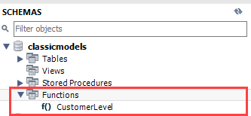
Once the function is created, you can view it in MySQL Workbench under the Functions section:

Slide 9

Or you can view all stored functions in the current classicmodels database by using the SHOW FUNCTION STATUS as follows:
SHOW FUNCTION STATUS
WHERE db = 'classicmodels’;

Slide 10
Calling a stored function in an SQL statement
The following statement uses the CustomerLevel stored function:
SELECT
customerName,
CustomerLevel(creditLimit)
FROM
customers
ORDER BY
customerName;

Slide 11
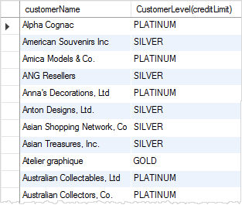

Slide 12
Calling a stored function in a stored procedure
The following statement creates a new stored procedure that calls the CustomerLevel() stored function:
DELIMITER $$
CREATE PROCEDURE GetCustomerLevel(
IN customerNo INT,
OUT customerLevel VARCHAR(20)
)
BEGIN
DECLARE credit DEC(10,2) DEFAULT 0;
-- get credit limit of a customer

Slide 13
SELECT
creditLimit
INTO credit
FROM customers
WHERE
customerNumber = customerNo;
-- call the function
SET customerLevel = CustomerLevel(credit);
END$$
DELIMITER ;

Slide 14
The following illustrates how to call the GetCustomerLevel() stored procedure:
CALL GetCustomerLevel(-131,@customerLevel);
SELECT @customerLevel;
It’s important to notice that if a stored function contains SQL statements that query data from tables, then you should not use it in other SQL statements; otherwise, the stored function will slow down the speed of the query.

Slide 15
Thank You
Please Subscribe My Channel
https://www.youtube.com/channel/UCYW3PWPOPn3qgxxjhUbXXXg?view_as=subscriber

